Slide 1
Reader and Writer Problem
Dining Philosopher Problem

Slide 2
Readers-Writers Problem
A data set is shared among a number of concurrent processes
  Readers – only read the data set; they do not perform any updates
  Writers – can both read and write
Problem – allow multiple readers to read at the same time
Only one single writer can access the shared data at the same time
Several variations of how readers and writers are treated – all involve priorities
Shared Data
  Data set
  Semaphore rw_mutex initialized to 1
  Semaphore mutex initialized to 1
  Integer read_count initialized to 0

Slide 3
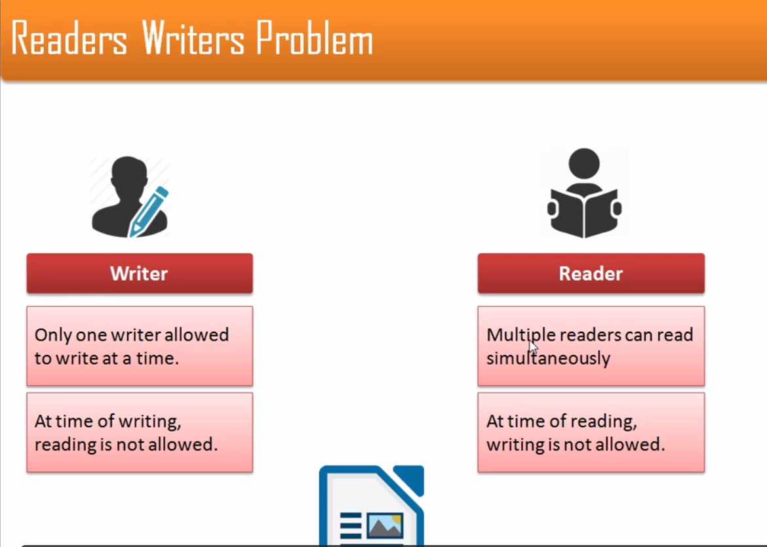

Slide 4
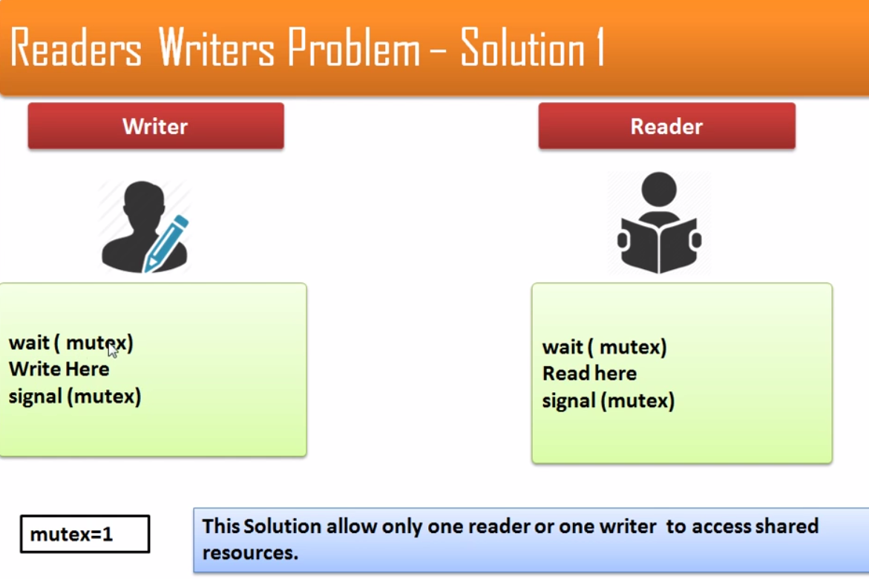

Slide 5
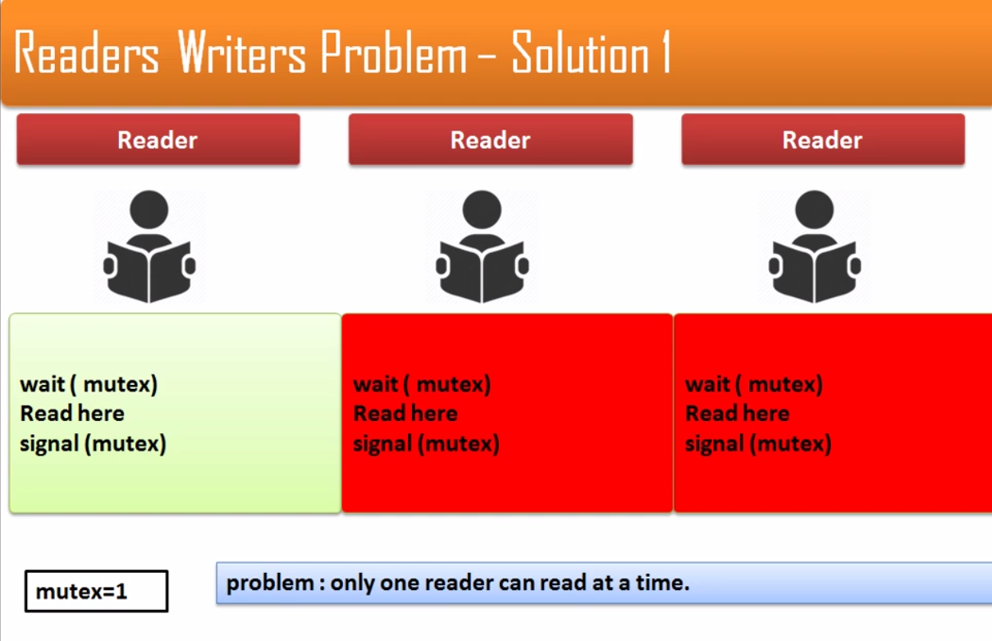

Slide 6
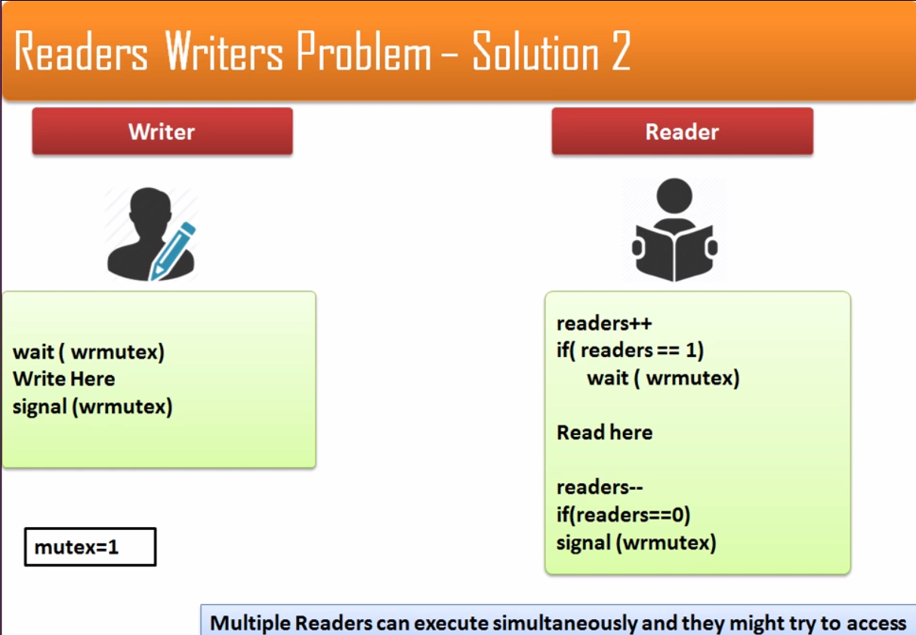

Slide 7
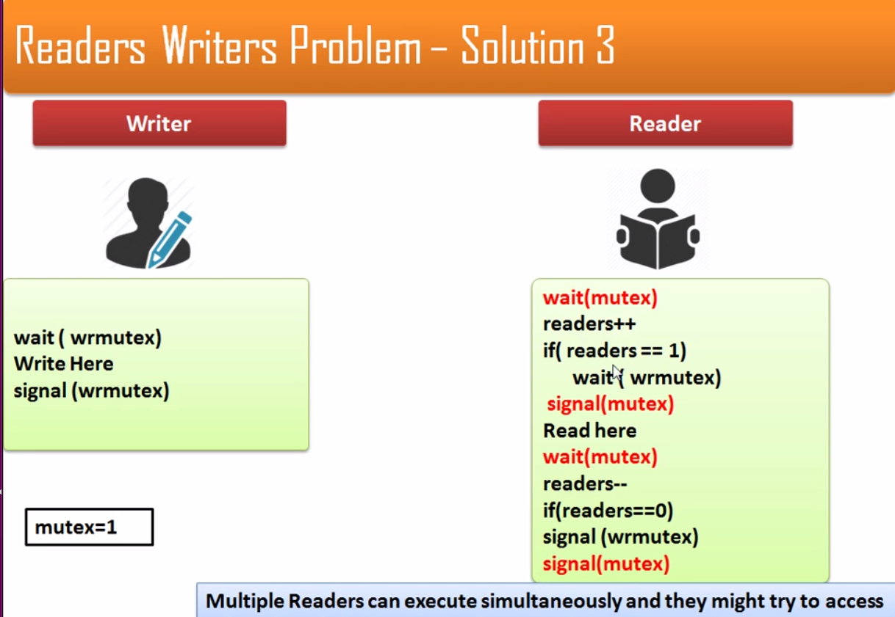

Slide 8
Readers-Writers Problem (Cont.)
The structure of a writer process
do {
wait(rw_mutex);
...
/* writing is performed */
...
signal(rw_mutex);
} while (true);

Slide 9
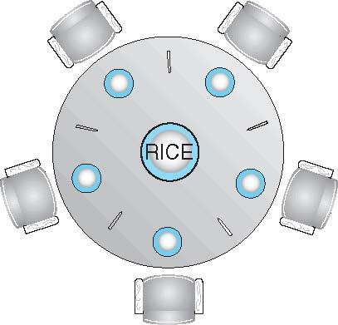
Dining-Philosophers Problem
Philosophers spend their lives thinking and eating
Don’t interact with their neighbors, occasionally try to pick up 2 chopsticks (one at a time) to eat from bowl
  Need both to eat, then release both when done
In the case of 5 philosophers
  Shared data
    Bowl of rice (data set)
    Semaphore chopstick [5] initialized to 1

Slide 10
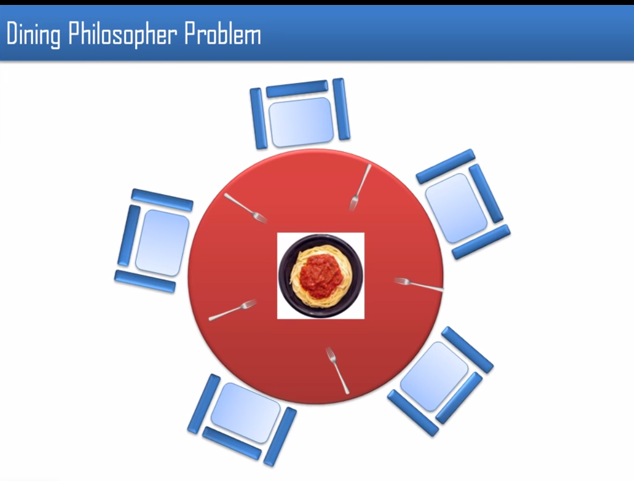

Slide 11
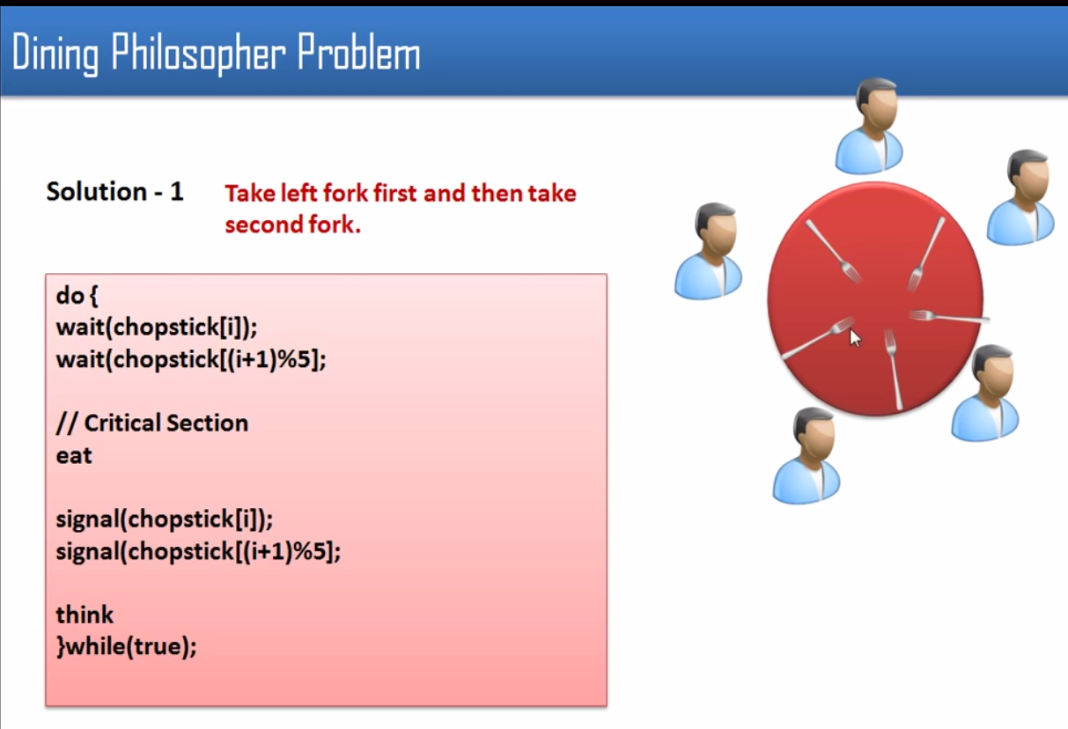

Slide 12
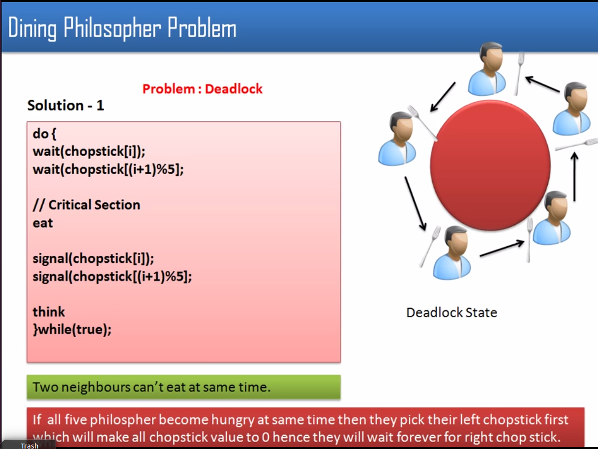

Slide 13
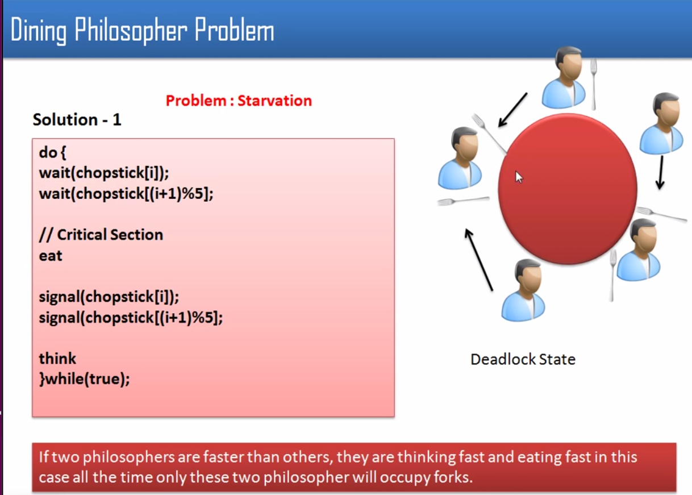

Slide 14
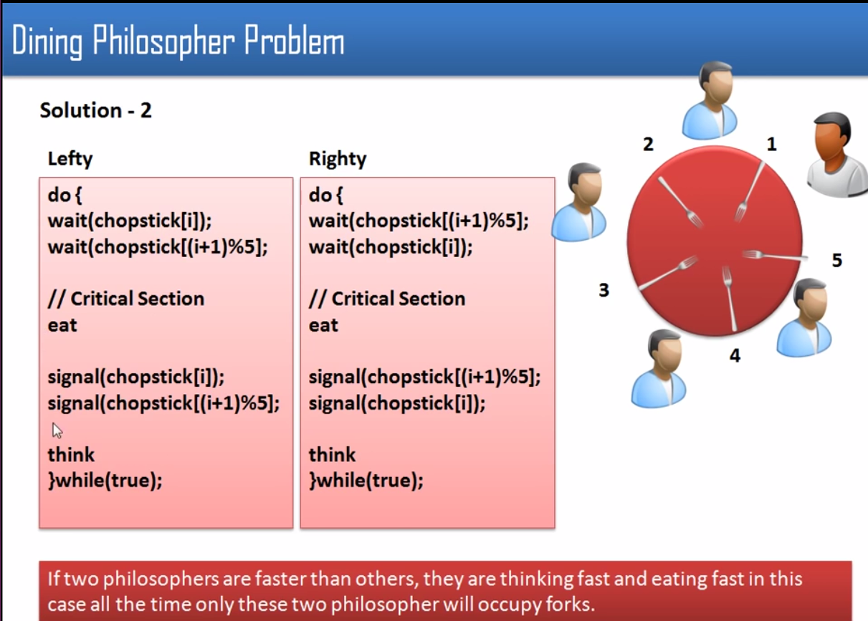

Slide 15
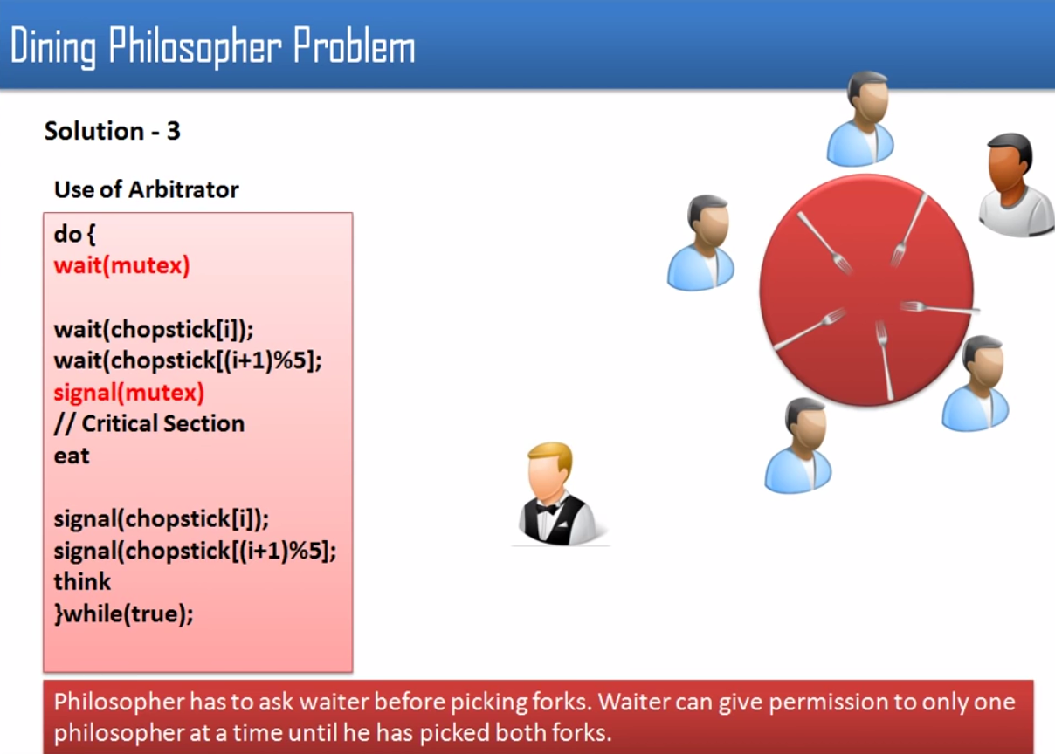

Slide 16
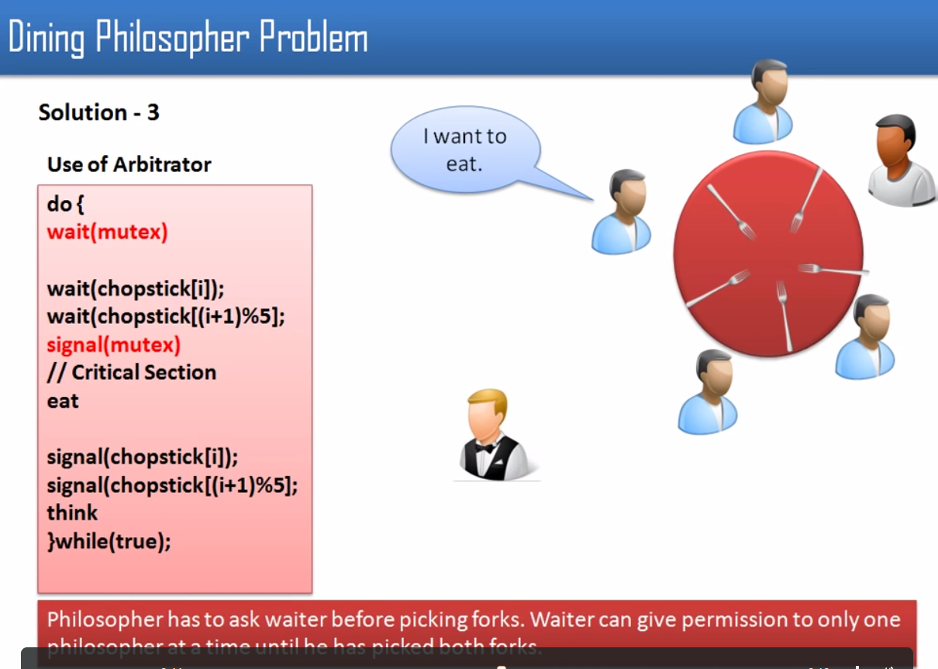

Slide 17
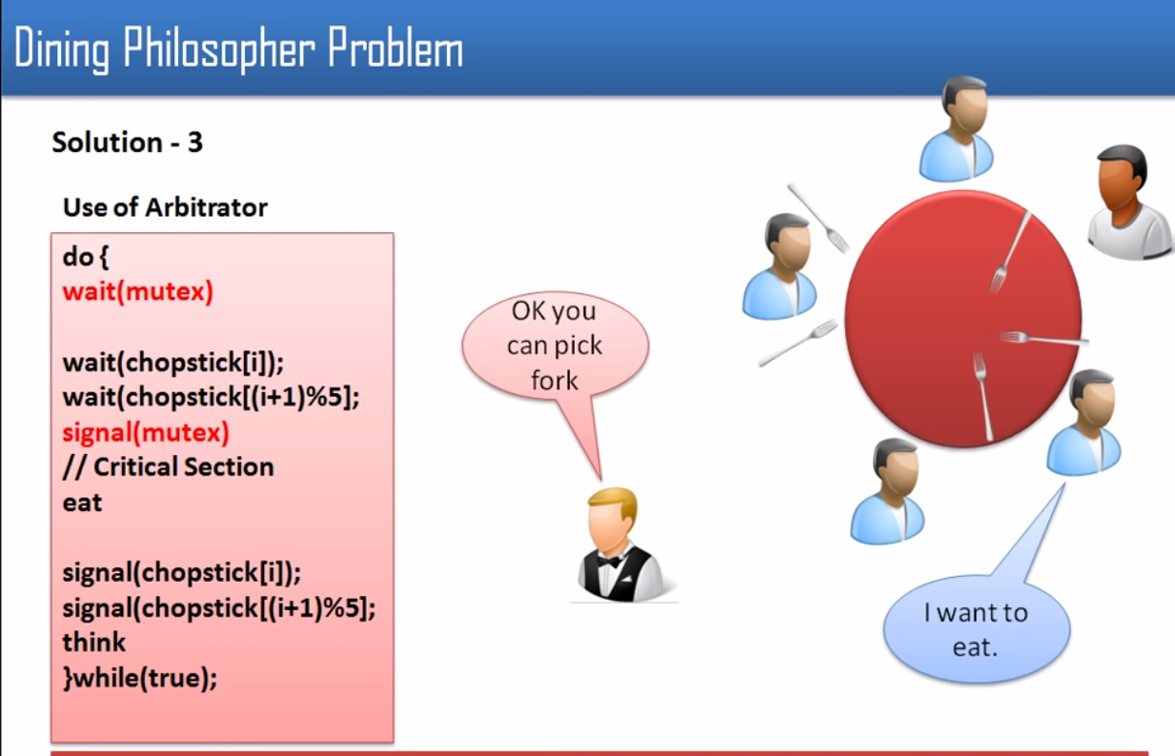

Slide 18
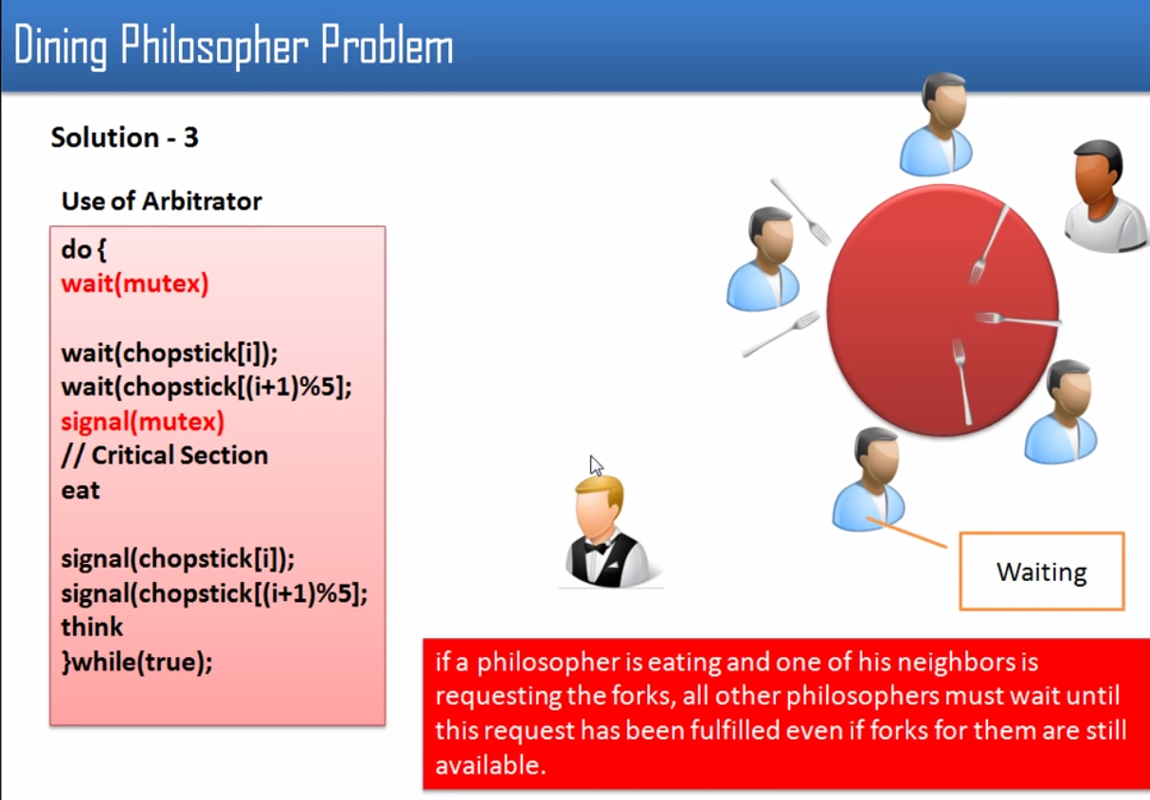

Slide 19
Solution to Dining Philosophers
monitor DiningPhilosophers
{
enum { THINKING; HUNGRY, EATING)
state [5] ;
condition self [5];
void pickup (int i) {
state[i] = HUNGRY;
test(i);
if (state[i] != EATING)
self [i].wait;
}
void putdown (int i) {
state[i] = THINKING;
// test left and right neighbors
test((i + 4) % 5);
test((i + 1) % 5);
}

Slide 20
Solution to Dining Philosophers (Cont.)
void test (int i) {
if ( (state[(i + 4) % 5] != EATING) &&
(state[i] == HUNGRY) &&
(state[(i + 1) % 5] != EATING) ) {
state[i] = EATING ;
self[i].signal () ;
}
}
initialization_code() {
for (int i = 0; i < 5; i++)
state[i] = THINKING;
}
}

Slide 21
Solution to Dining Philosophers (Cont.)
Each philosopher i invokes the operations pickup() and putdown() in the following sequence:
DiningPhilosophers.pickup(i);
EAT
DiningPhilosophers.putdown(i);
No deadlock, but starvation is possible

Slide 22
Monitors
A high-level abstraction that provides a convenient and effective mechanism for process synchronization
Abstract data type, internal variables only accessible by code within the procedure
Only one process may be active within the monitor at a time
But not powerful enough to model some synchronization schemes
monitor monitor-name
{
// shared variable declarations
procedure P1 (…) { …. }
procedure Pn (…) {……}
Initialization code (…) { … }
}
}

Slide 23
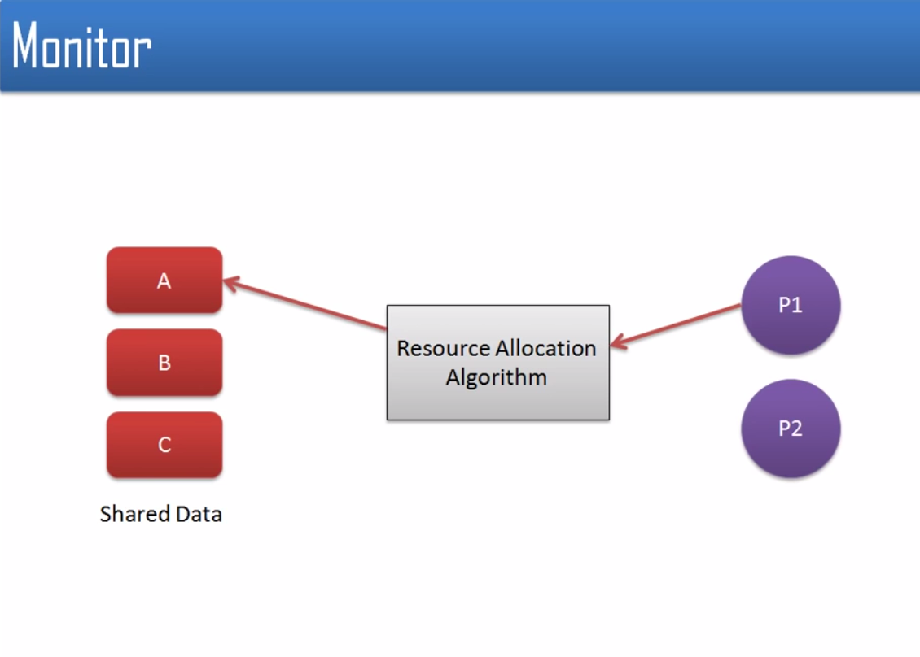

Slide 24
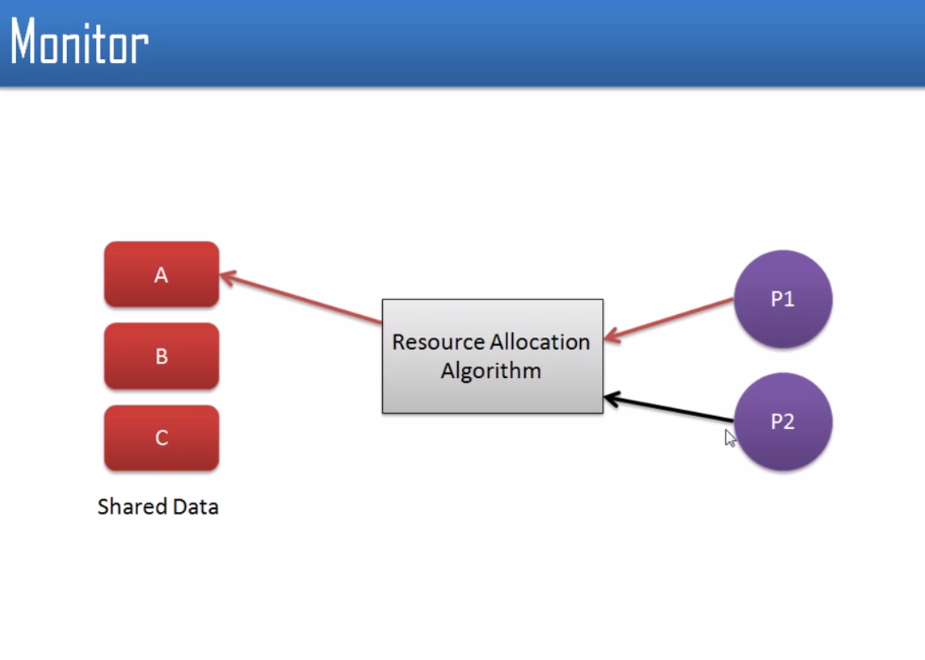

Slide 25
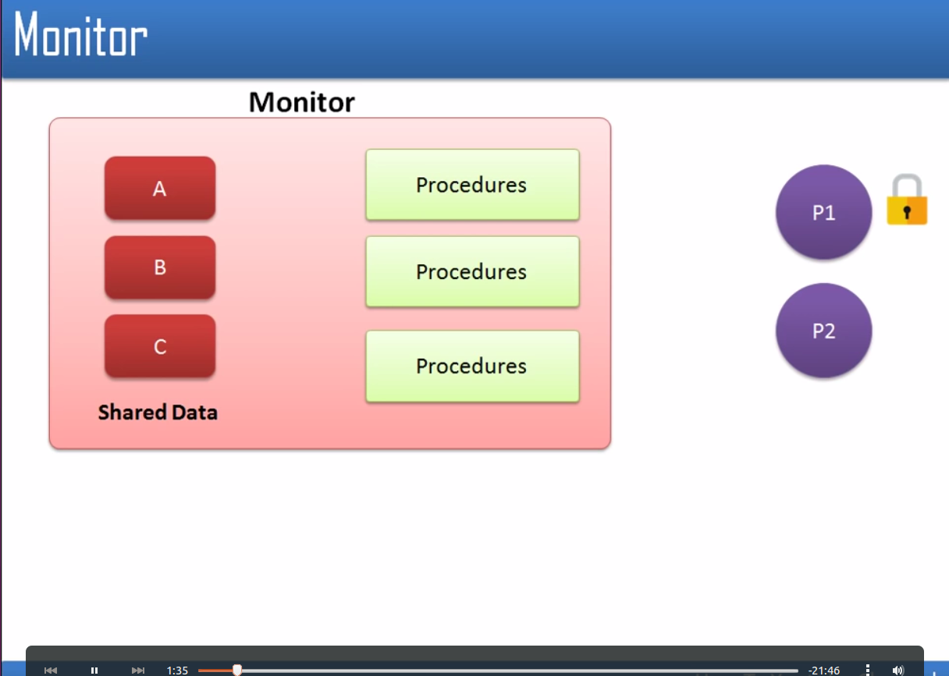

Slide 26
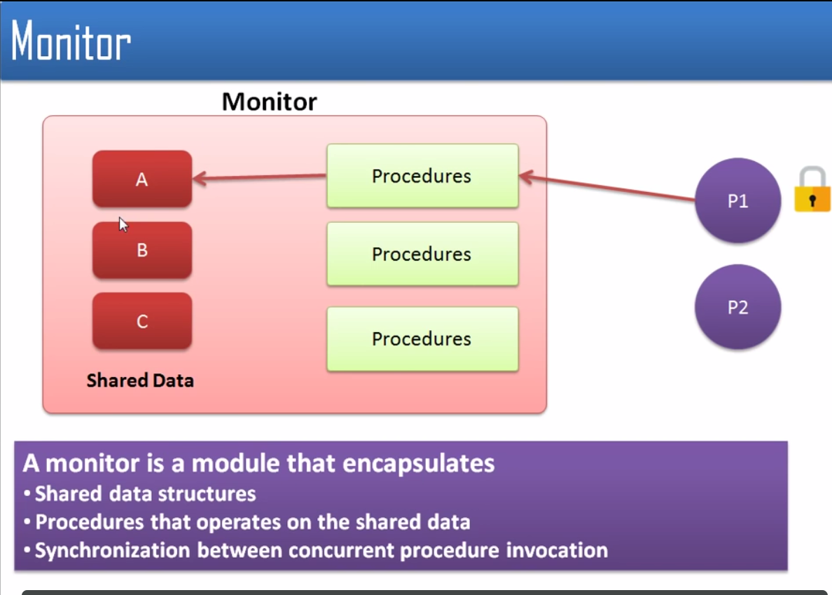

Slide 27
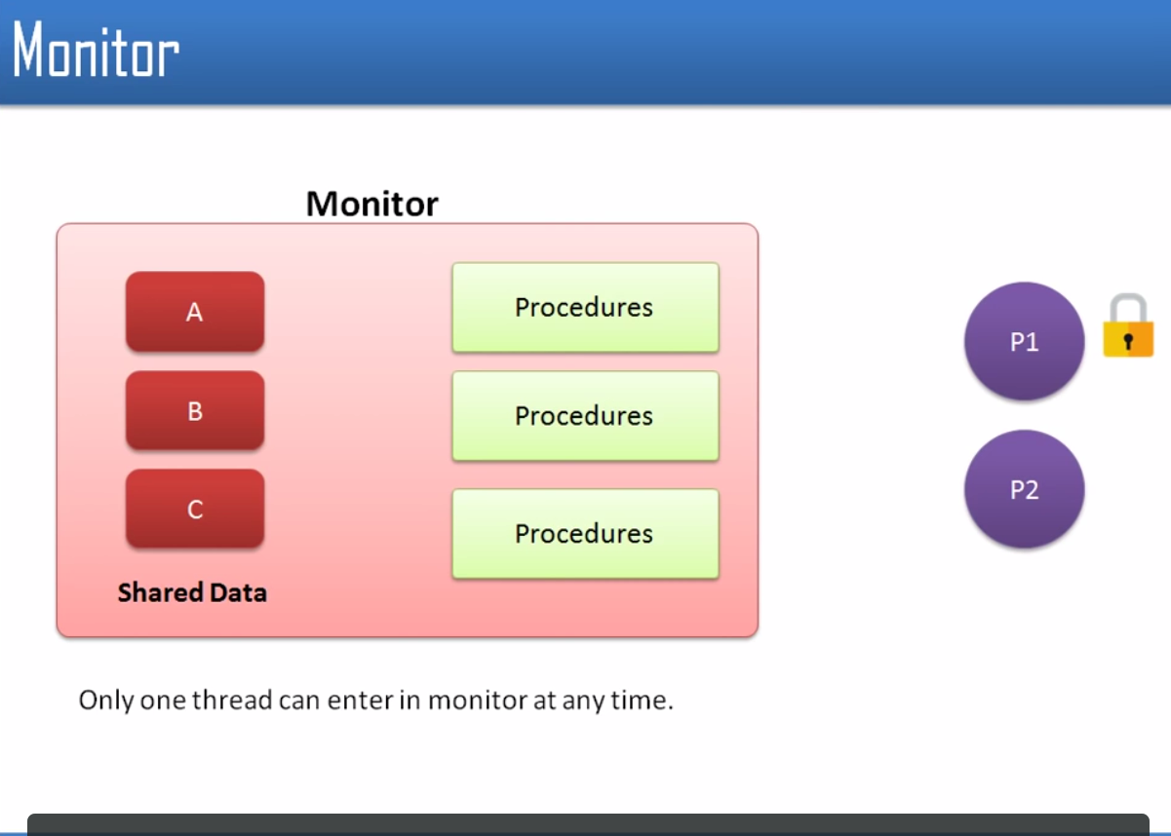

Slide 28
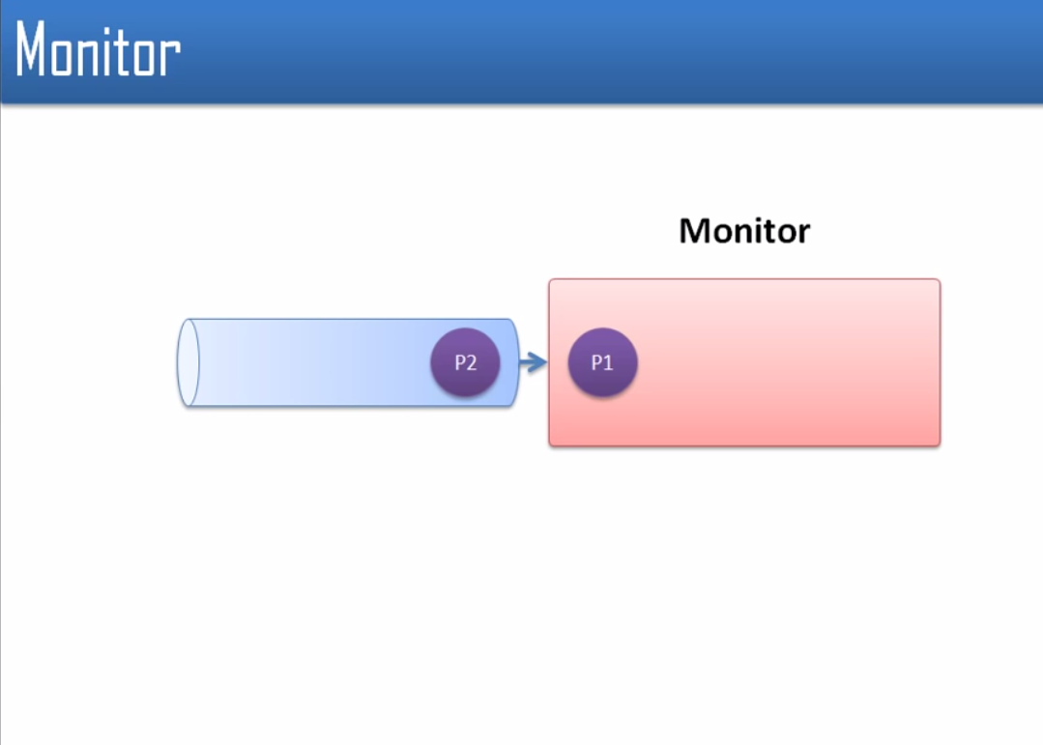

Slide 29
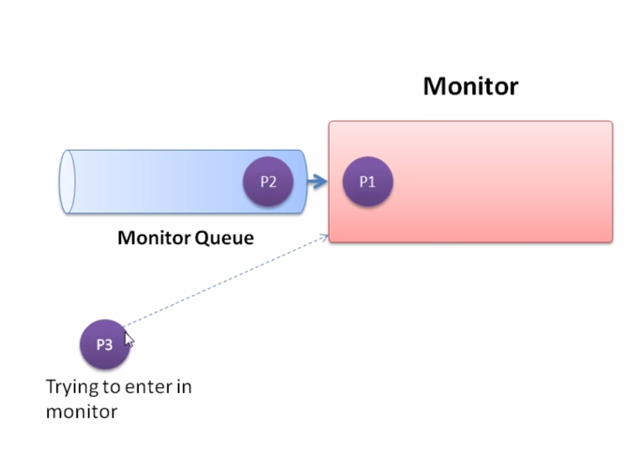

Slide 31
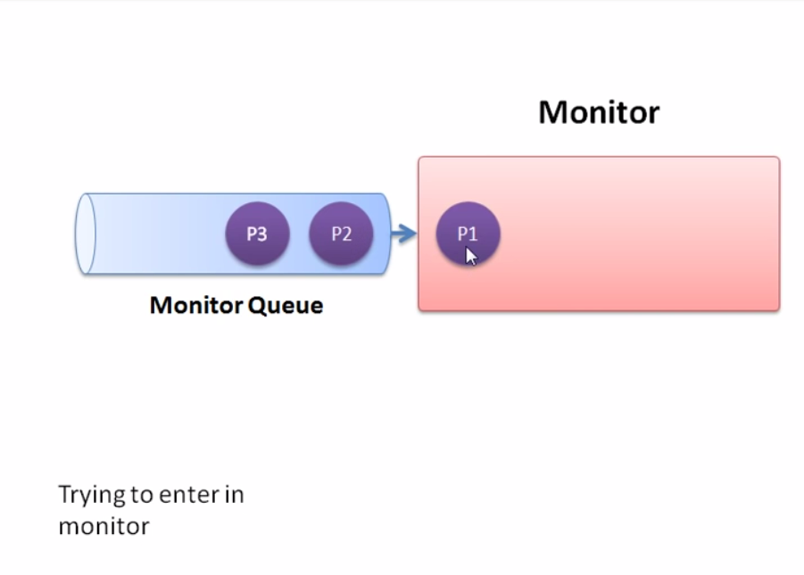

Slide 32
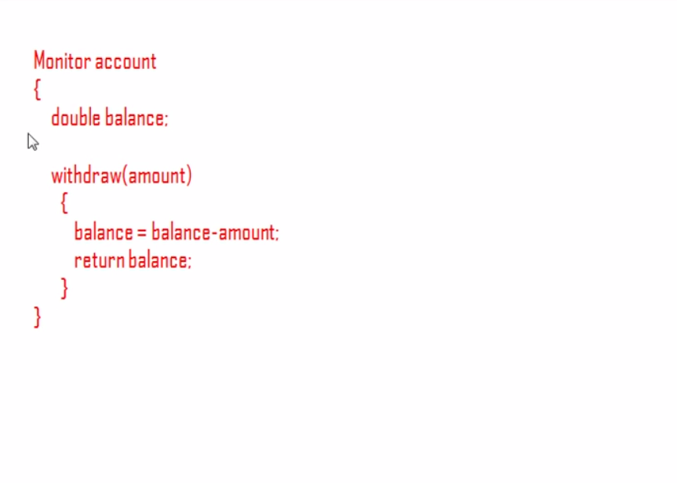

Slide 33
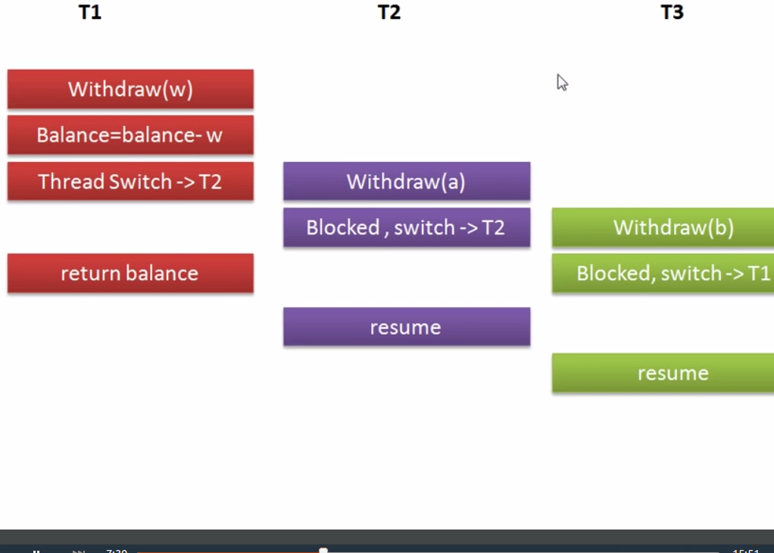

Slide 34
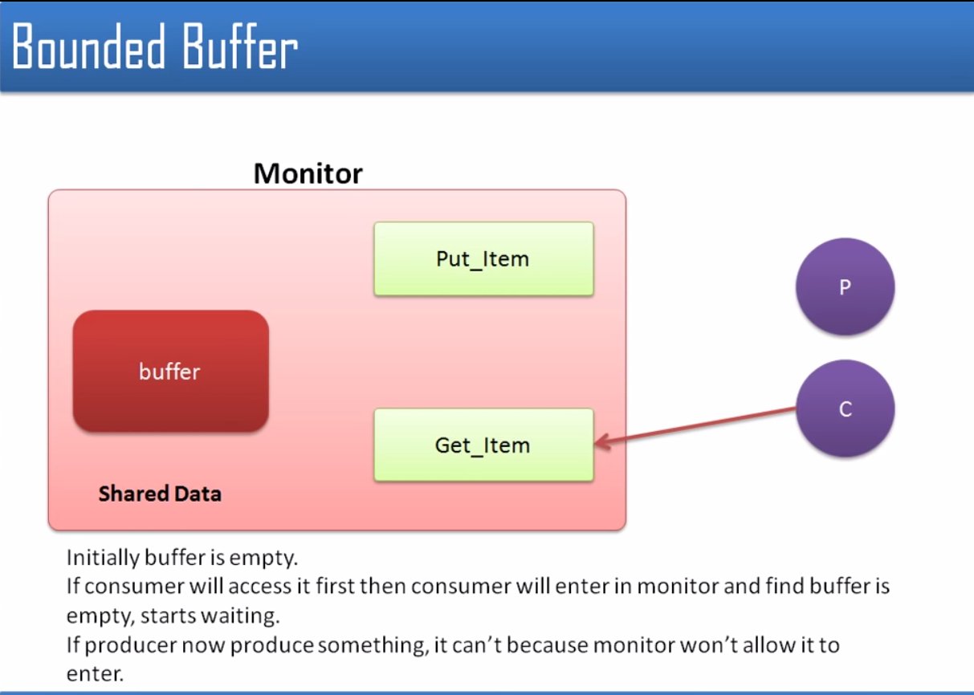

Slide 35
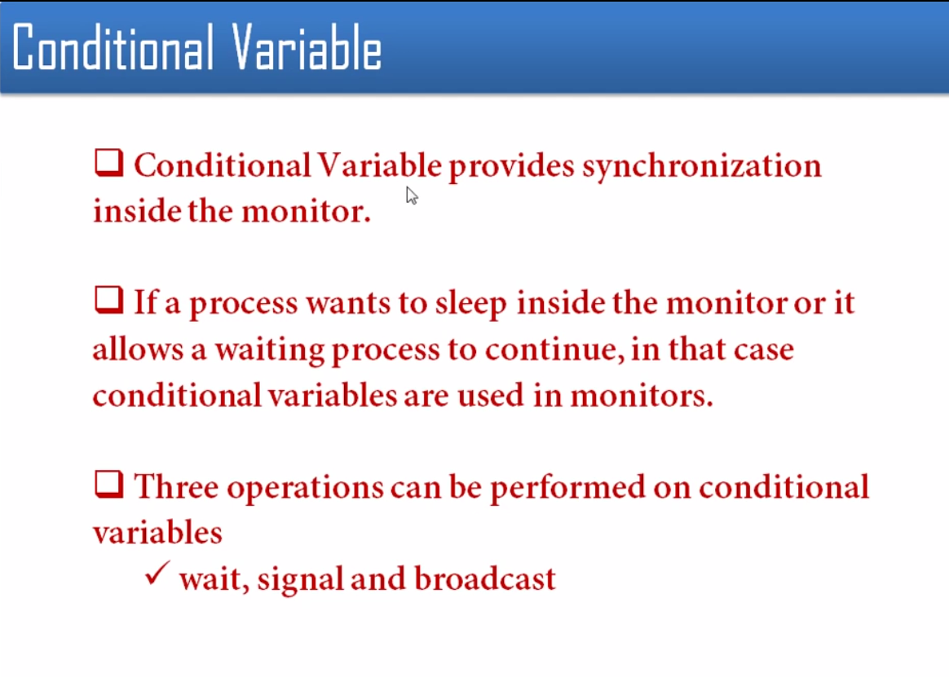

Slide 36
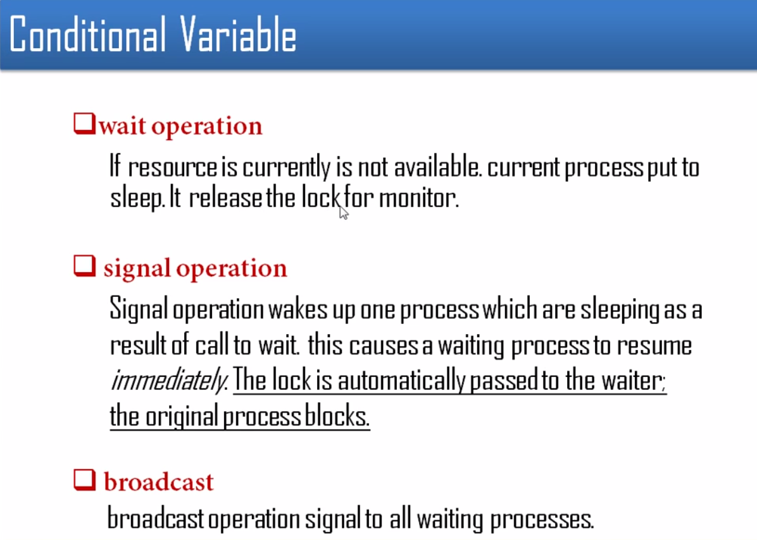

Slide 37
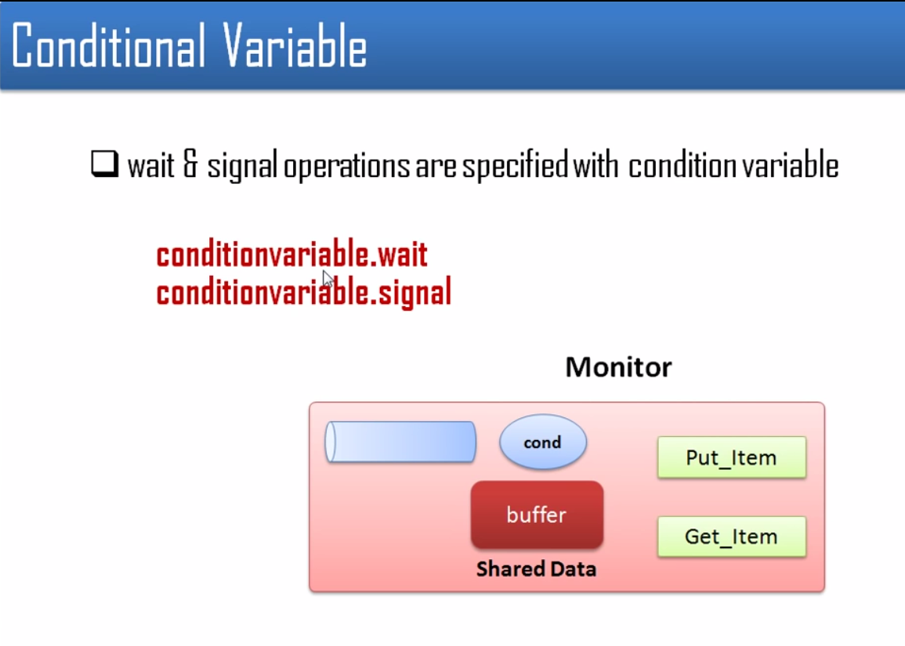

Slide 38
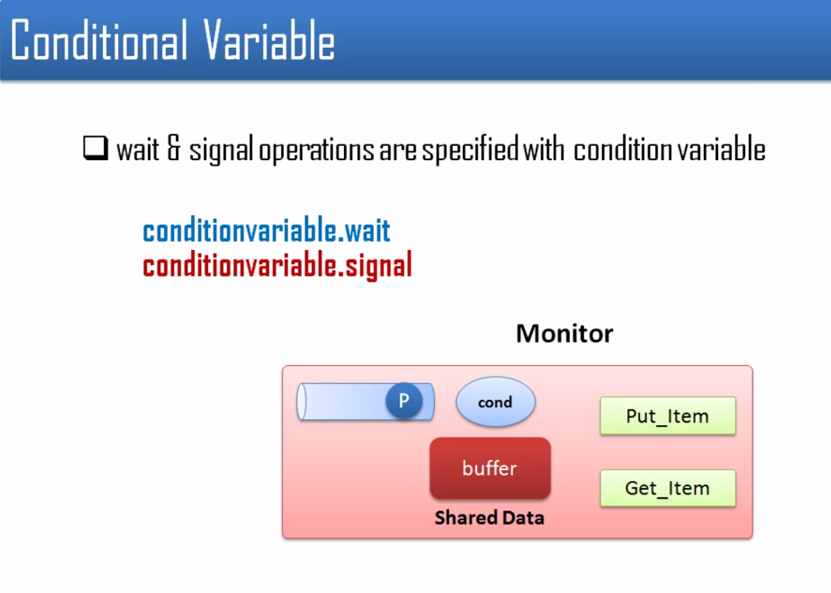

Slide 39
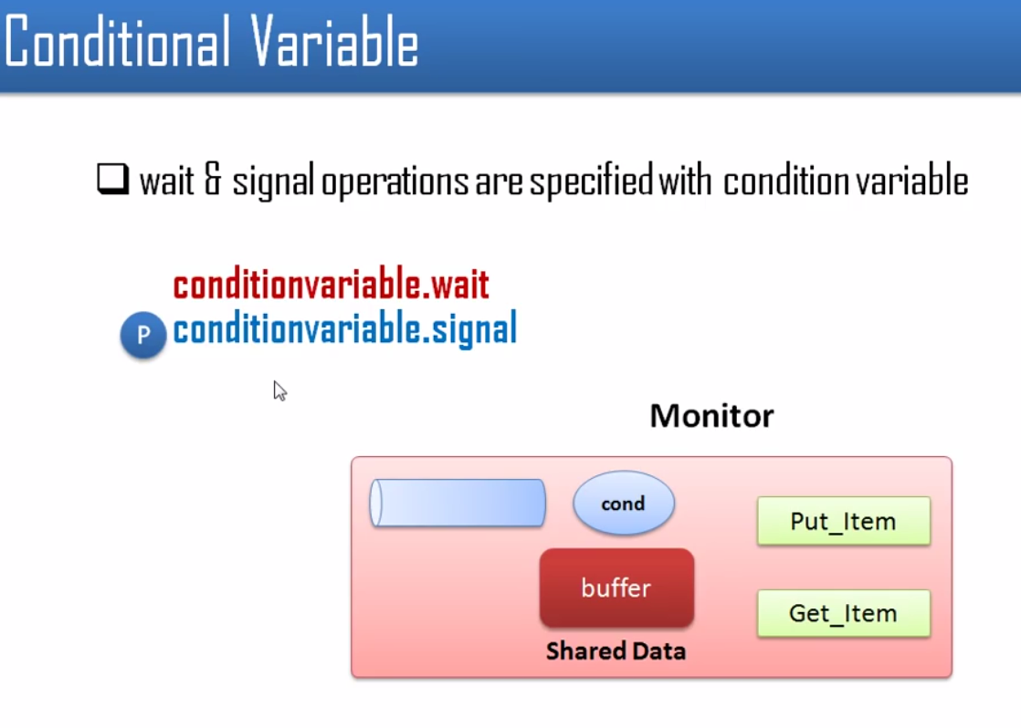

Slide 40
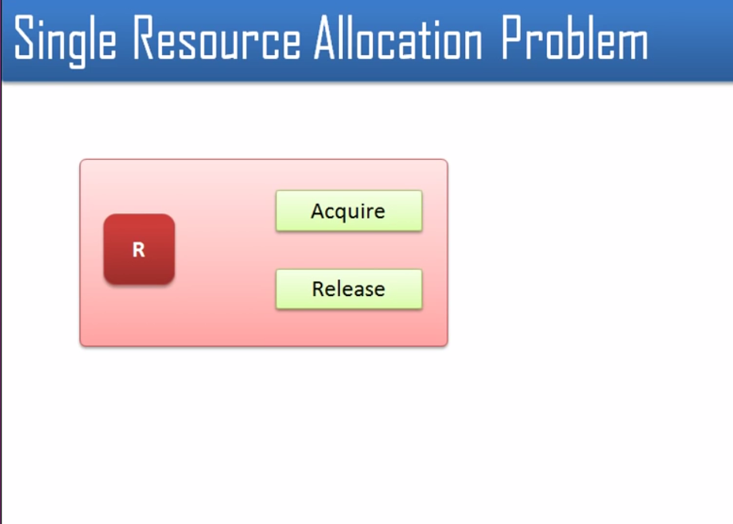

Slide 41
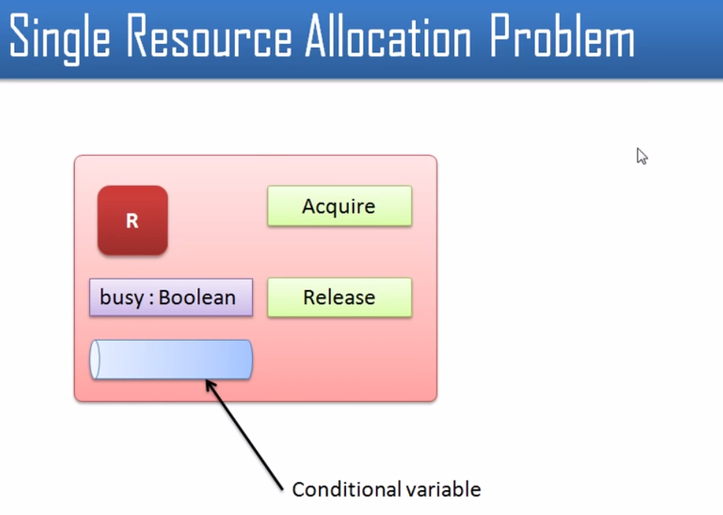

Slide 42
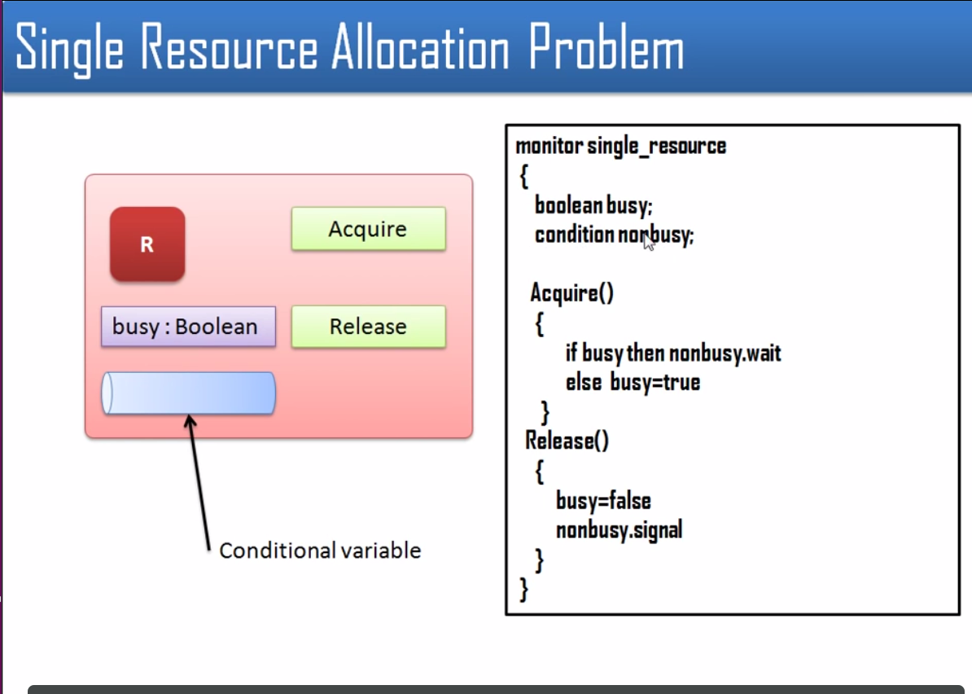

Slide 43
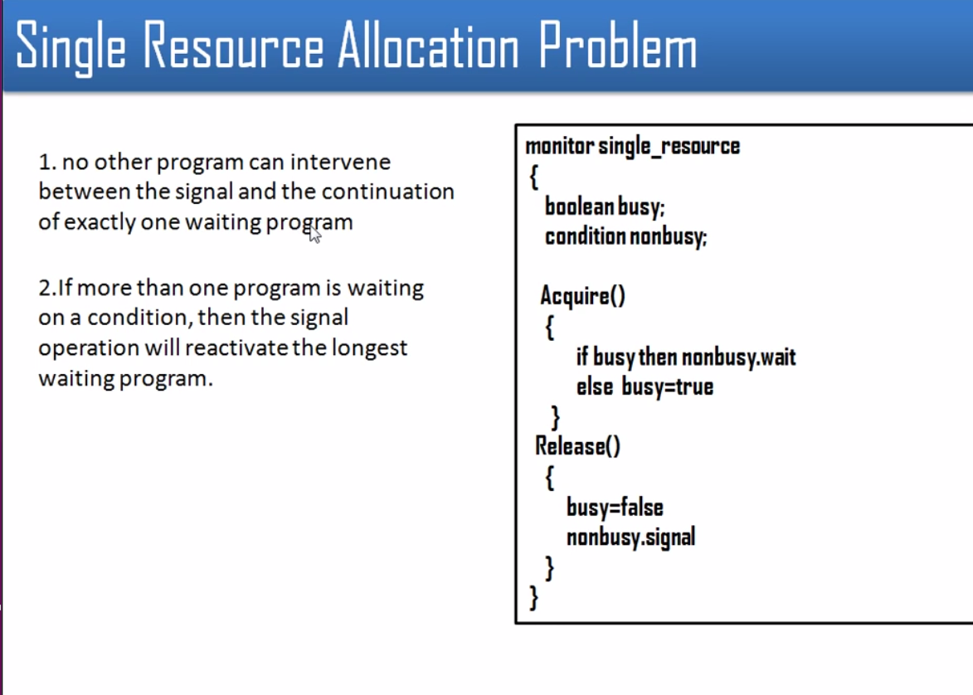

Slide 44
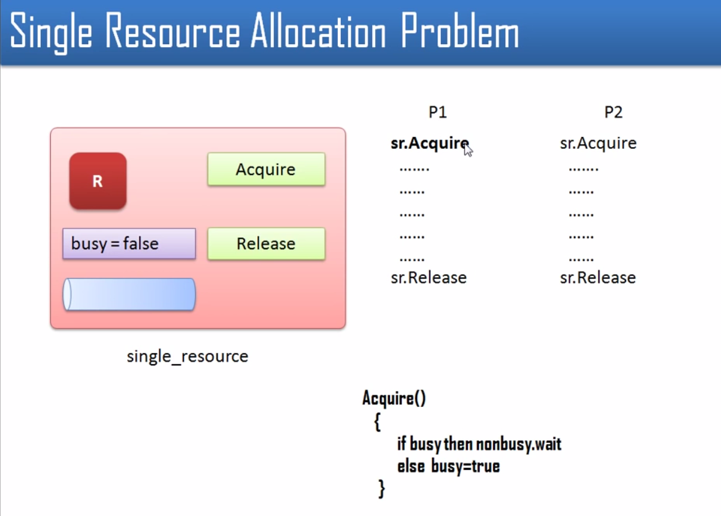

Slide 45
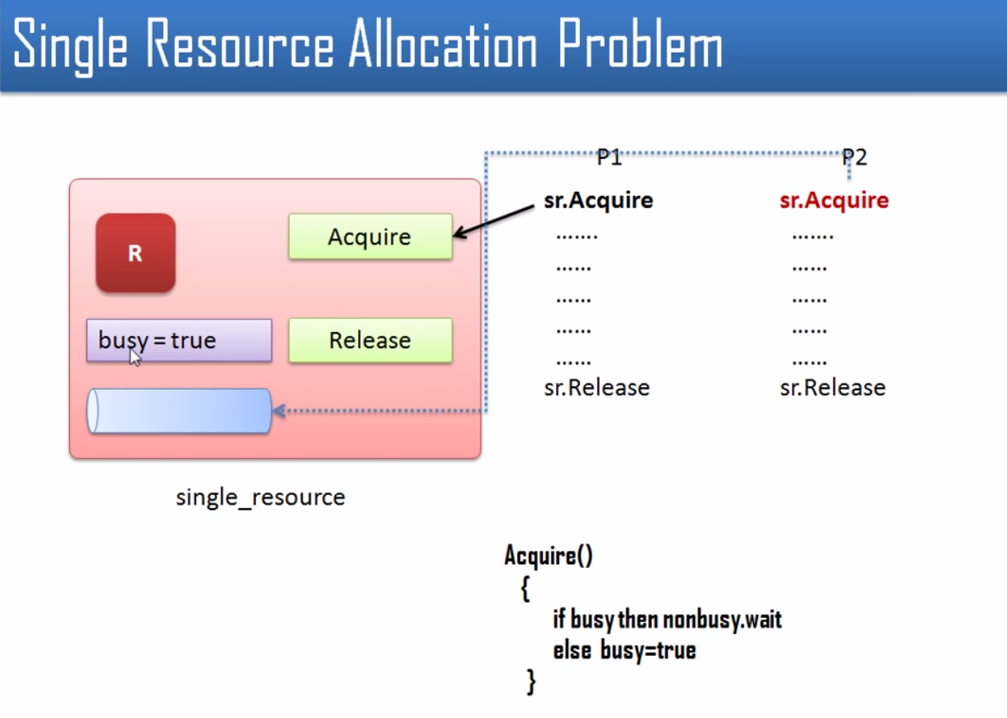

Slide 46


